Slide 1
Projection
A looser…………..

Slide 2

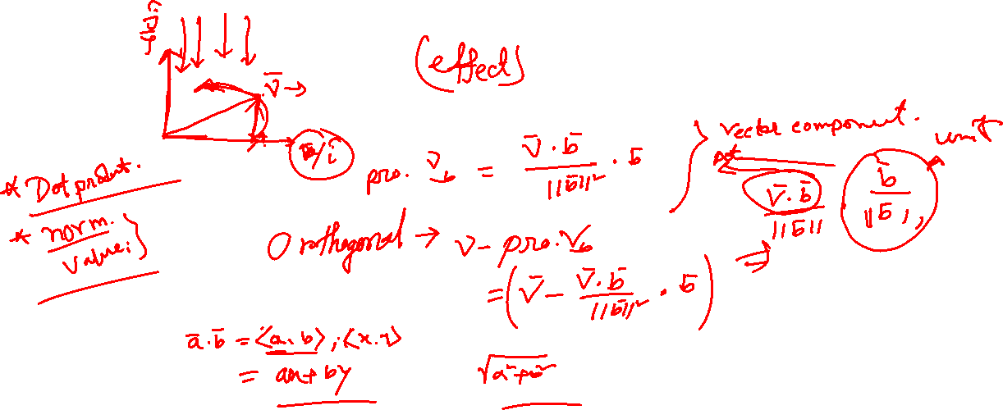









Projection

Slide 3

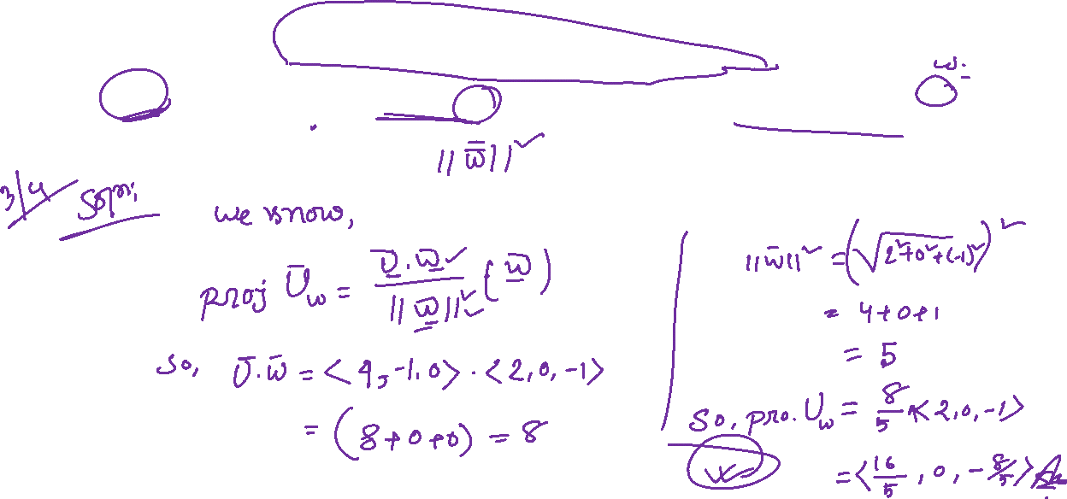
A little practice……
Spring 24

Slide 4
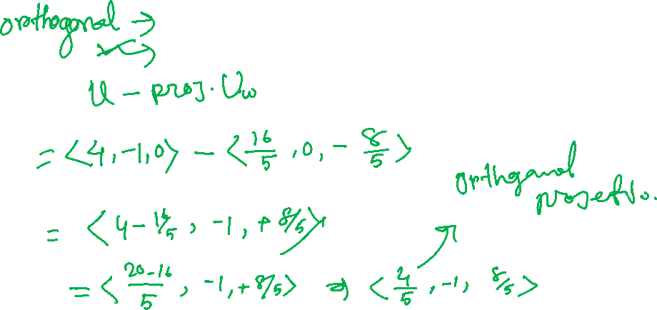

Slide 5

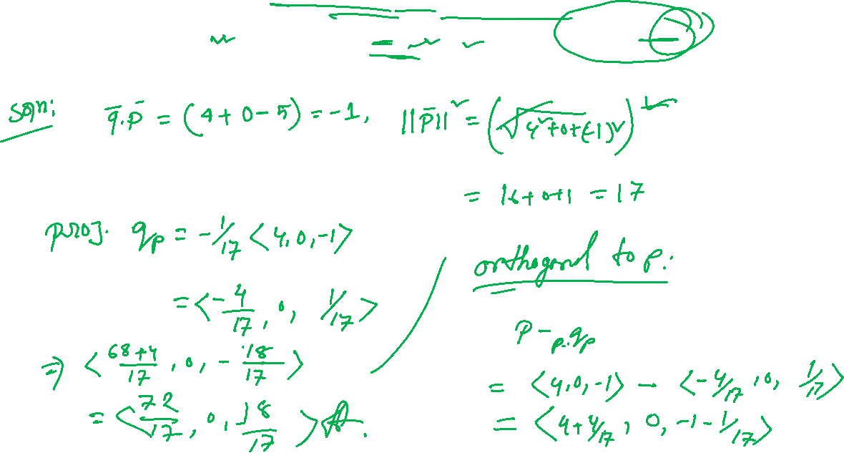
1 More
Fall 23

Slide 6

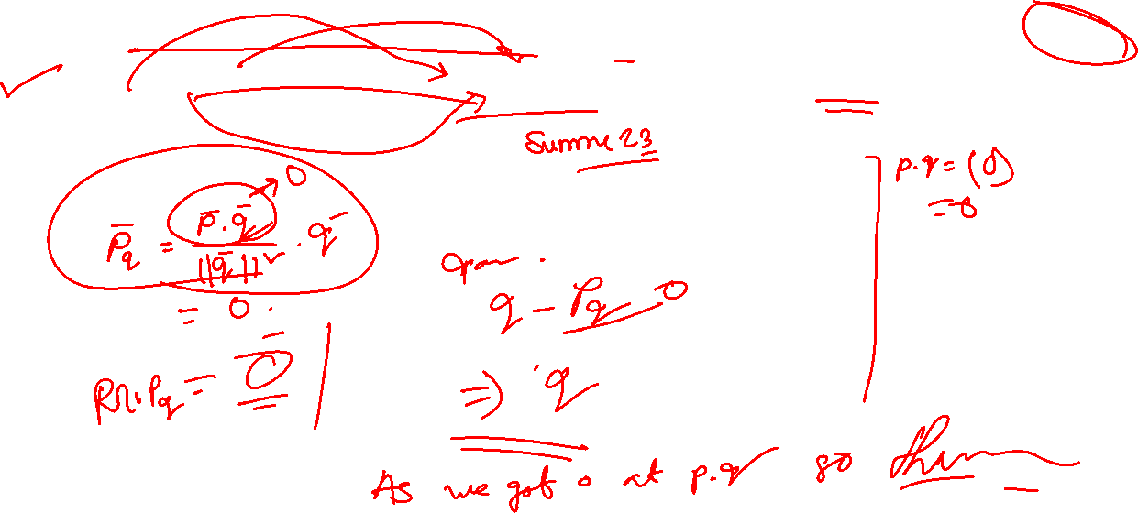
The last of this Tinnyyyy thing’s

Slide 7
I think that’s Quite Enough For Battle…..

